Slide 1

Examining the Performance of Satellite Propagators for Autonomous Space-Situational-Awareness Satellites
Capstone Project Phase A
24-2-R-13
Mahran Abed Ellatif
Shadi Abed Alkarem
Supervisor: Elad Denenberg

Slide 2
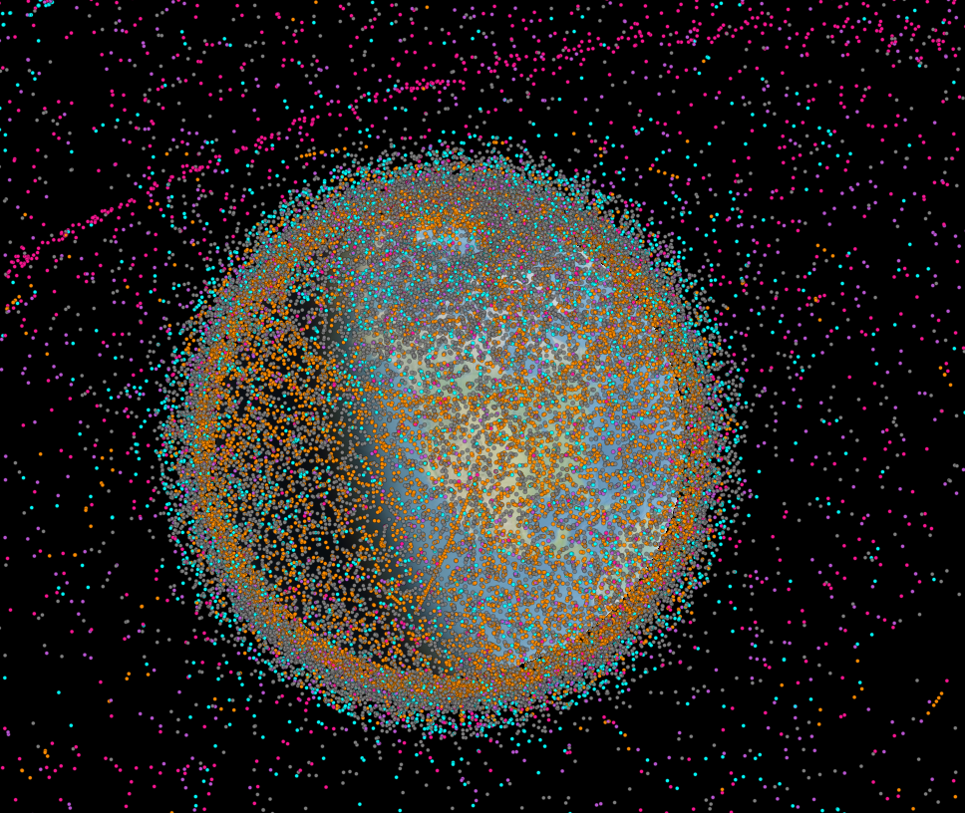
Introduction
Active\Old Satellites, Space debris
The growing space debris problem
Importance of autonomous navigation and collision avoidance
six state propagation algorithms
Active satellites[orange]
Inactive satellites[Blue]
Space debris[Grey]
Rocket bodies[purple]
Uncategorized[pink]
1
2
3
4
5
6
7
8
9
10
Introduction
Background
Objective
Algorithms
Analysis
Testing
Results
Conclusion
Future Work

Slide 3
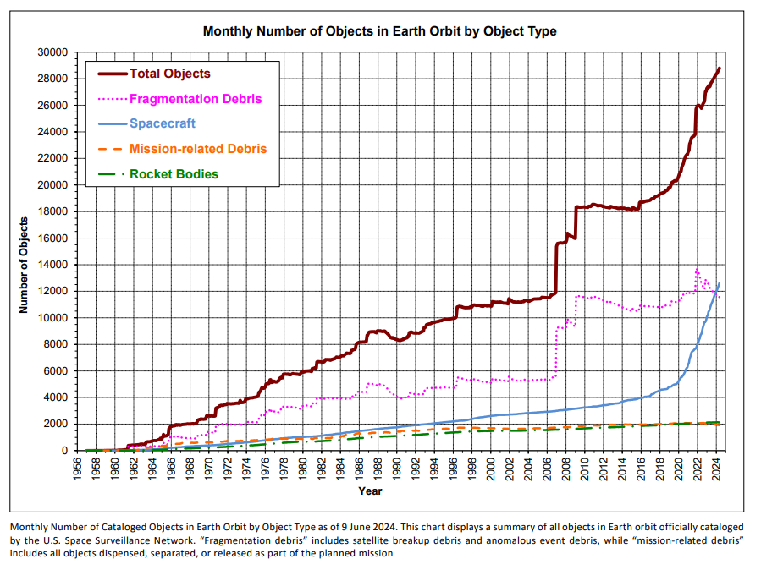
1
2
3
4
5
6
7
8
9
10
Introduction
Background
Objective
Algorithms
Analysis
Testing
Results
Conclusion
Future Work

Slide 4
Background
Space Environment and Collision Risks
Growing satellite population and debris.
Autonomous satellites need precise algorithms for collision avoidance.
LEMUR2[green] – COSMOS[blue]
1
2
3
4
5
6
7
8
9
10
Introduction
Background
Objective
Algorithms
Analysis
Testing
Results
Conclusion
Future Work
4

Slide 5
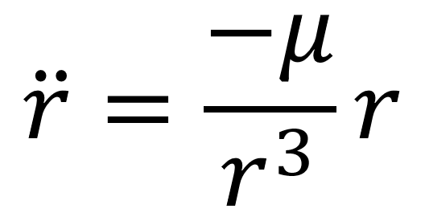
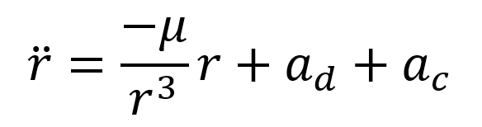
Background & Related Work
Existing Algorithms for State Propagation
RK4,RK8,ODE45,ODE78,ODE113 and MPCI
Equations of motion
SGP4 Standard General Perturbations Satellite Orbit Model 4
1
2
3
4
5
6
7
8
9
10
Introduction
Background
Objective
Algorithms
Analysis
Testing
Results
Conclusion
Future Work
5

Slide 6
Objectives of the Study
Evaluate Performance of six algorithms for state propagation
Simulation testing with real satellite data
Identify the most effective algorithm for autonomous satellite navigation
1
2
3
4
5
6
7
8
9
10
Introduction
Background
Objective
Algorithms
Analysis
Testing
Results
Conclusion
Future Work
6

Slide 7
Selected Algorithms
Over view
4th Order Runge-Kutta method-RK4
8th Order Runge-Kutta method-RK8
Dormand-Prince Method-ODE45
Verner’s Method-ODE78
Adam-Bashforth-Moulton PECE Solver-ODE113
Modified Picard-Chebyshev Iteration-MPCI
1
2
3
4
5
6
7
8
9
10
Introduction
Background
Objective
Algorithms
Analysis
Testing
Results
Conclusion
Future Work
7

Slide 8
Algorithms Analysis
4th Order Runge-Kutta method-RK4
Numerical solution for ODE’s
Balance between accuracy and computational efficiency
Key Points
Time Complexity O(N)
Space Complexity O(N) – ” Originally O(1)”
Suitable for-time Application with moderate accuracy requirements
1
2
3
4
5
6
7
8
9
10
Introduction
Background
Objective
Algorithms
Analysis
Testing
Results
Conclusion
Future Work
8

Slide 9
Algorithms Analysis
8th Order Runge-Kutta method-RK8
High-Order accuracy with higher computational cost
Key Points
Time Complexity O(N)
Space Complexity O(N) – ” Originally O(1)”
Suitable for precise but less time-constrained applications
1
2
3
4
5
6
7
8
9
10
Introduction
Background
Objective
Algorithms
Analysis
Testing
Results
Conclusion
Future Work
9

Slide 10
Algorithms Analysis
Dormand-Prince Method-ODE45
Adaptive step size method, Balances accuracy and efficiency
Key Points
Time Complexity O(N)
Space Complexity O(N) – ” Originally O(1)”
Useful for varied solution behavior
1
2
3
4
5
6
7
8
9
10
Introduction
Background
Objective
Algorithms
Analysis
Testing
Results
Conclusion
Future Work
10

Slide 11
Algorithms Analysis
Verner’s Method-ODE78
Provides high accuracy with variable step size for efficiency
Key Points
Time Complexity O(N)
Space Complexity O(N) – ” Originally O(1)”
Suitable for high-precision applications where stringent accuracy is required
1
2
3
4
5
6
7
8
9
10
Introduction
Background
Objective
Algorithms
Analysis
Testing
Results
Conclusion
Future Work
11

Slide 12
Algorithms Analysis
Adam-Bashforth-Moulton PECE Solver-ODE113
Predicts using explicit methods and corrects using implicit methods
Key Points
Time Complexity O(N)
Space Complexity O(N) – ” Originally O(1)”
Efficient for non-stiff problem over long time intervals
1
2
3
4
5
6
7
8
9
10
Introduction
Background
Objective
Algorithms
Analysis
Testing
Results
Conclusion
Future Work
12

Slide 13
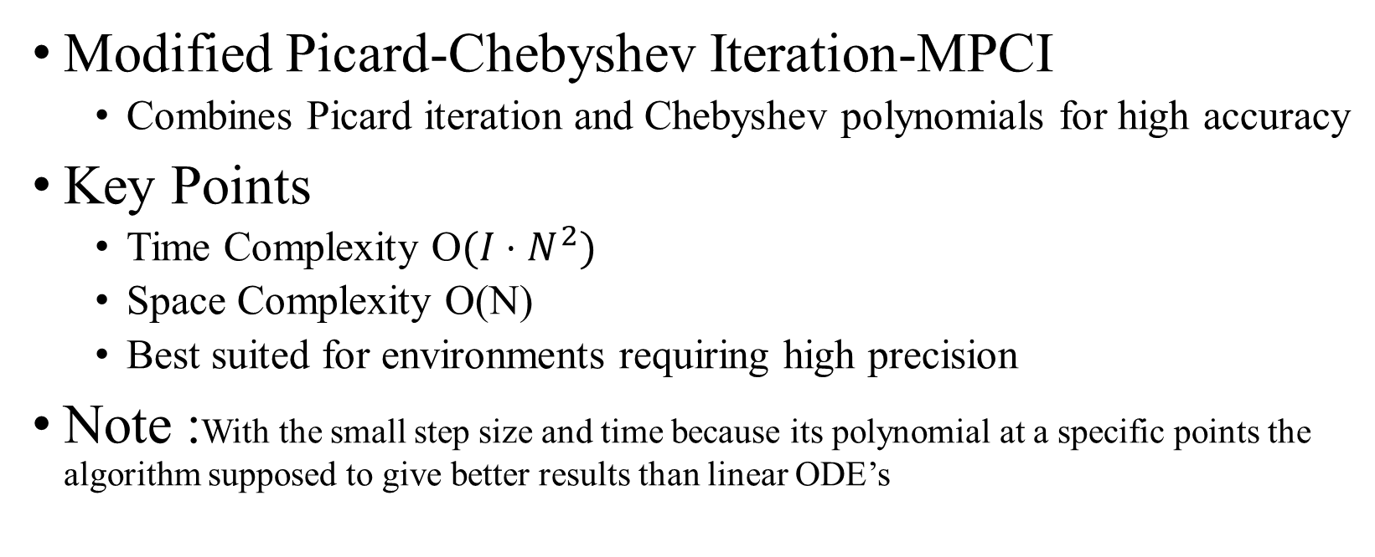
Algorithms Analysis
Modified Picard-Chebyshev Iteration-MPCI
Combines Picard iteration and Chebyshev polynomials for high accuracy
Key Points
Time Complexity O$(I⋅N^{2})$
Space Complexity O(N)
Best suited for environments requiring high precision
Note :With the small step size and time because its polynomial at a specific points the algorithm supposed to give better results than linear ODE’s
1
2
3
4
5
6
7
8
9
10
Introduction
Background
Objective
Algorithms
Analysis
Testing
Results
Conclusion
Future Work
13

Slide 14
Preliminary Testing Setup
We tested each algorithm using real satellite TLE data for initial conditions and the general motion of equation with only gravity.
With six random satellites (5 Low Earth Orbit and 1 High Elliptical Orbit)
Simulations were run over 30-second time span ,and each algorithm’s results were compared to the SGP4 Model
With step size of 0.1
Key metric included position and velocity differences, as well as execution time for each algorithm.
1
2
3
4
5
6
7
8
9
10
Introduction
Background
Objective
Algorithms
Analysis
Testing
Results
Conclusion
Future Work
14

Slide 15
Results Overview
We evaluated the accuracy of each algorithm by comparing their results to the SGP4 model.
Execution time was also a critical factor in assessing their practicality for real-time applications.
the results revealed trade-offs between computational efficiency and accuracy across different algorithms.
1
2
3
4
5
6
7
8
9
10
Introduction
Background
Objective
Algorithms
Analysis
Testing
Results
Conclusion
Future Work
15

Slide 16
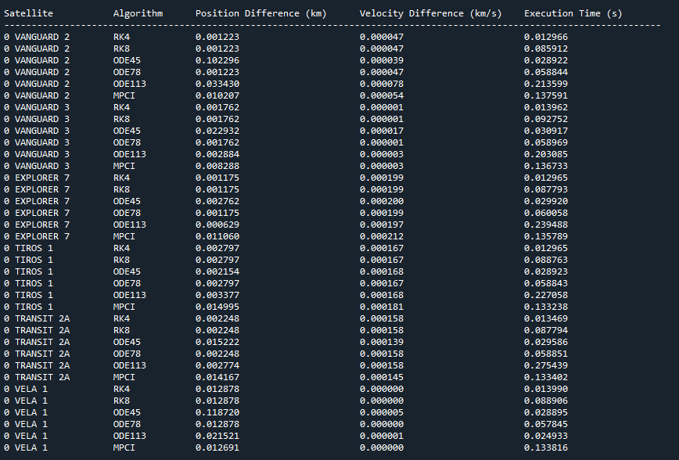
1
2
3
4
5
6
7
8
9
10
Introduction
Background
Objective
Algorithms
Analysis
Testing
Results
Conclusion
Future Work
16

Slide 17
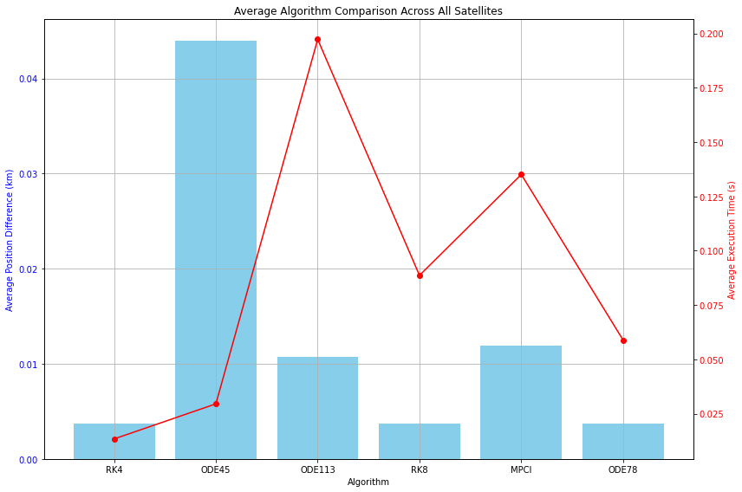
Results Average algorithm Comparison
1
2
3
4
5
6
7
8
9
10
Introduction
Background
Objective
Algorithms
Analysis
Testing
Results
Conclusion
Future Work
17

Slide 18
Algorithms Results
RK4: showed the smallest average position difference, balancing accuracy and speed.
RK8: High accuracy, but with increased computational cost.
ODE45: Efficient in terms of computation, but less accurate for satellite state propagation.
ODE78 and ODE113: Offered high accuracy with good computational performance, making them ideal for precise applications.
MPCI: Provided high precision, but with longer execution times, requiring further optimization.
1
2
3
4
5
6
7
8
9
10
Introduction
Background
Objective
Algorithms
Analysis
Testing
Results
Conclusion
Future Work
18

Slide 19
Conclusion
RK4 and RK8 are the most balanced algorithms, with RK4 offering the best trade-off between accuracy and efficiency.
ODE45, while efficient, is less suitable for high-precision satellite positioning.
MPCI provides excellent precision but requires further optimization for real-time use.
ODE78 and ODE113 offer strong accuracy and performance, making them suitable for both real-time and extended simulation tasks.
1
2
3
4
5
6
7
8
9
10
Introduction
Background
Objective
Algorithms
Analysis
Testing
Results
Conclusion
Future Work
19

Slide 20
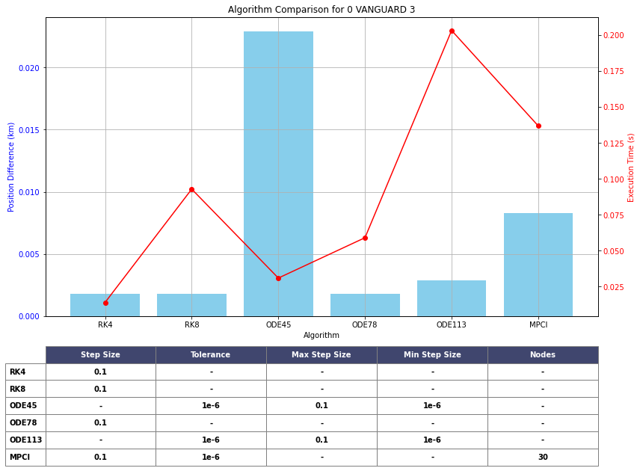
Future Work
Future work will involve implementing the top-performing algorithms in real CubeSat environments to test their effectiveness under actual operating conditions.
Further experimentation will focus on improving precision and efficiency across all algorithms.
Step-size
Time step
Tolerance
h-max/min
1
2
3
4
5
6
7
8
9
10
Introduction
Background
Objective
Algorithms
Analysis
Testing
Results
Conclusion
Future Work
20

Slide 21
Thank you
References
Kessler, D. J., & Cour-Palais, B. G. (1978). Collision frequency of artificial satellites: The creation of a debris belt.
https://www.researchgate.net/publication/23888776_Collision_frequency_of_artificial_satellites_-_The_creation_of_a_debris_belt
Runge, C. (1895). Über die numerische Auflösung von Differentialgleichungen. Mathematische Annalen.
https://www.researchgate.net/publication/230873346_Uber_die_numerische_Auflosung_von_Differentialgleichungen
Kutta, W. (1901). Beitrag zur näherungsweisen Integration totaler Differentialgleichungen. Zeitschrift für Mathematik und Physik.
https://www.researchgate.net/publication/200175415_Beitrag_zur_Naherungsweisen_Integration_totaler_Differentialgleichungen
Dormand, J. R., & Prince, P. J. (1980). A family of embedded Runge-Kutta formulae. Journal of Computational and Applied Mathematics.
https://www.researchgate.net/publication/222465749_A_Family_of_Embedded_Runge-Kutta_Formulae
Verner, J. L. (1988). A family of explicit Runge-Kutta methods for the numerical solution of ordinary differential equations ACM Transactions on Mathematical Software
https://dl.acm.org/doi/10.1145/285861.285863
Linear multistep method (Adam-bushforth-multon Formulas)
https://en.wikipedia.org/wiki/Linear_multistep_method
Denenberg, Elad. "Satellite closest approach calculation through Chebyshev Proxy Polynomials.“
https://www.researchgate.net/publication/338609111_Satellite_Closest_Approach_Calculation_Through_Chebyshev_Proxy_Polynomials
Woodland, R. A., & Junkins, J. L. (2007). Modified Picard-Chebyshev Iteration Methods for Solving Differential Equations. Journal of Computational Physics.
https://www.researchgate.net/publication/330092401_Nonlinear_Differential_Equation_Solvers_via_Adaptive_Picard-Chebyshev_Iteration_Applications_in_Astrodynamics
1
2
3
4
5
6
7
8
9
10
Introduction
Background
Objective
Algorithms
Analysis
Testing
Results
Conclusion
Future Work
21

